Slide 1
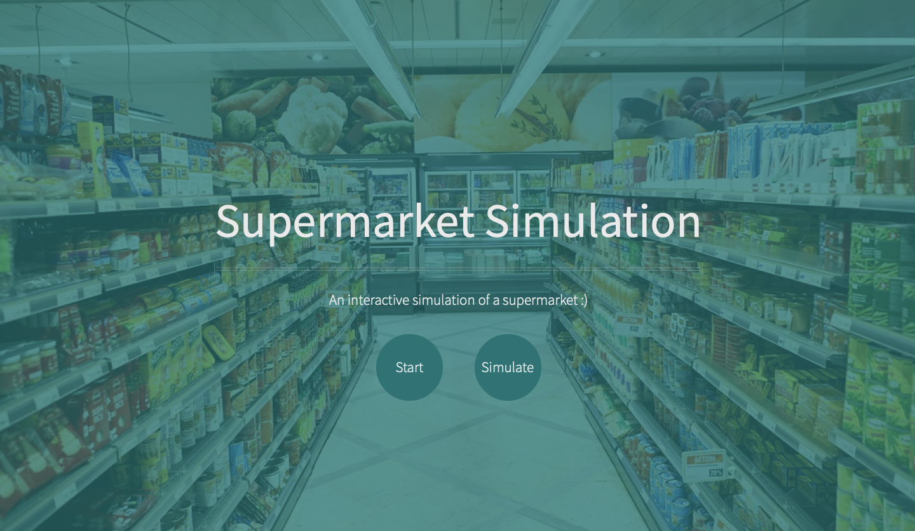
SUPERMARKET SIMULATION USER MANUAL
This ‘Start’ button will bring you to our content page
This ’Simulate’ button
will bring you to our
simulation page.

Slide 2
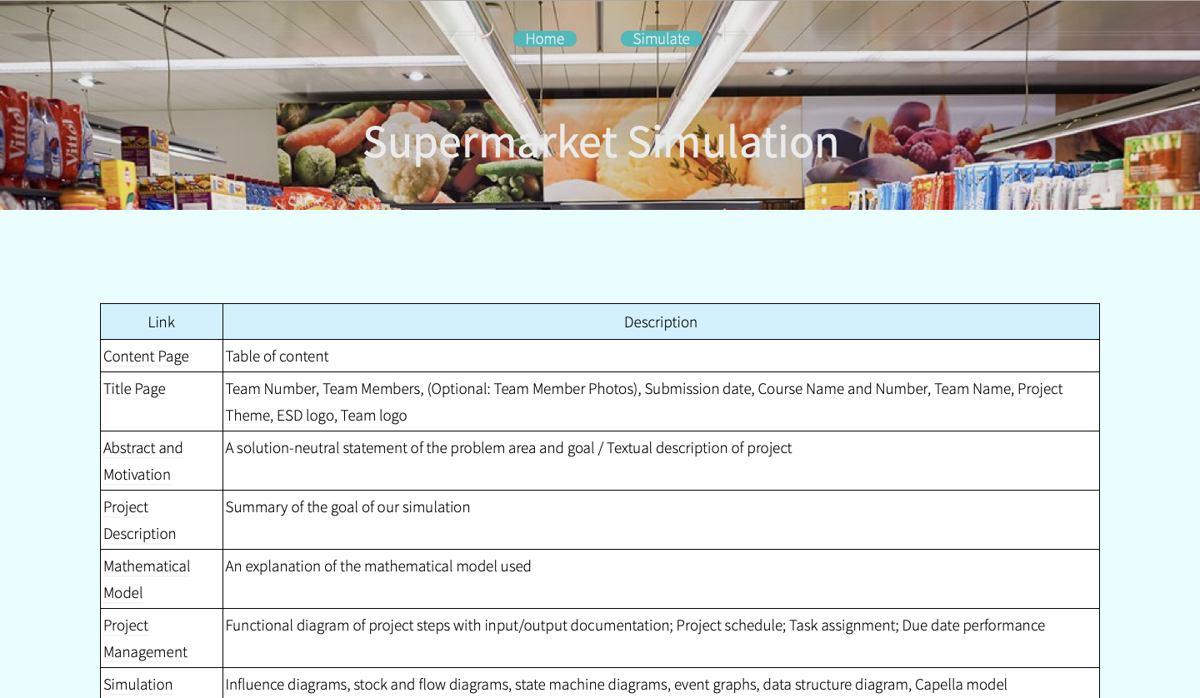
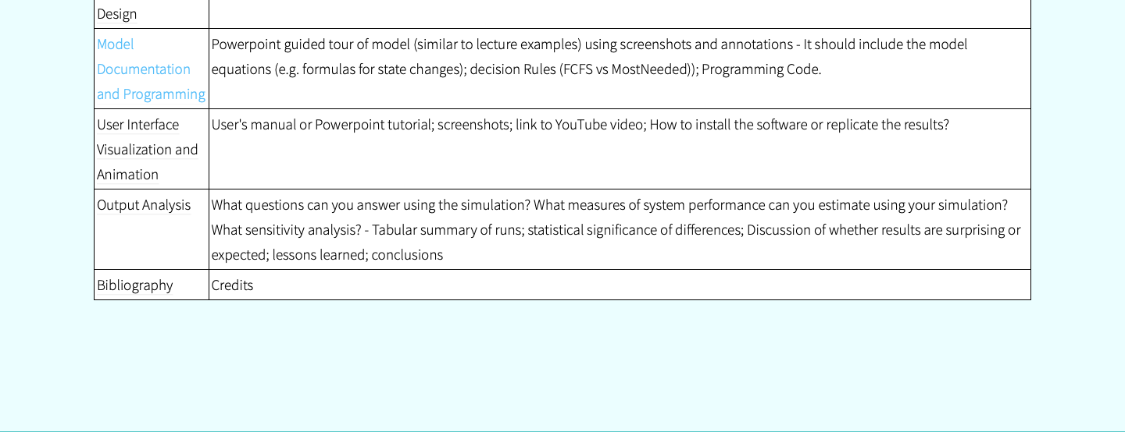
CONTENT
PAGE
This ’Simulate’ button
will bring you to our
simulation page.
This column includes
the links to the
different contents
that makes this project
a success.

Slide 3
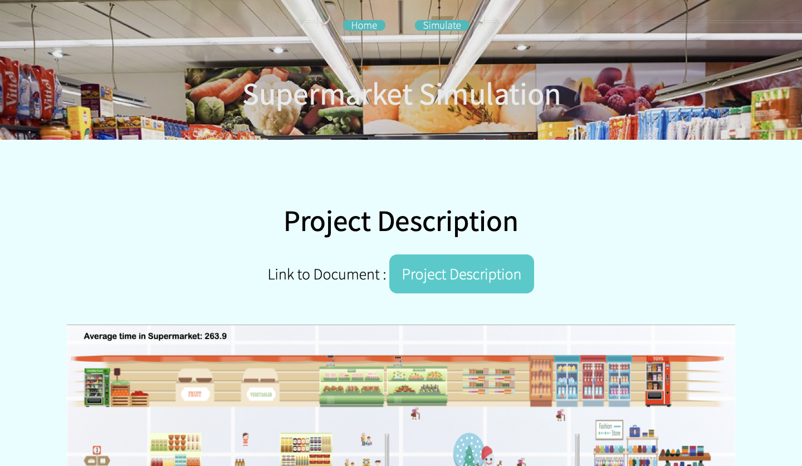
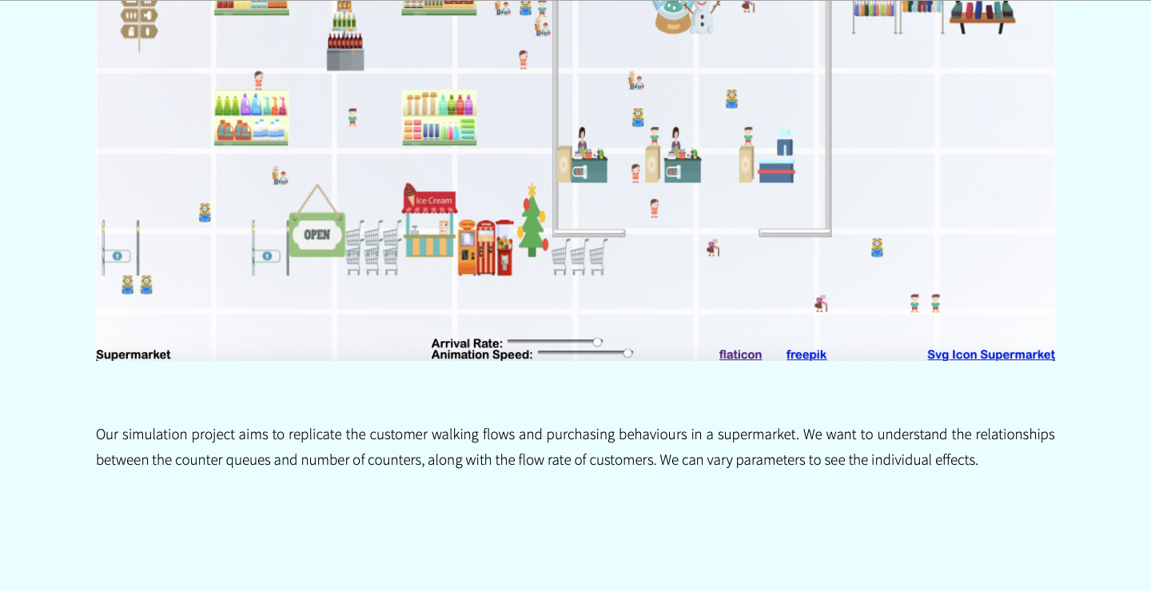
PROJECT
DESCRIPTION
This ’Simulate’ button
will bring you to our
simulation page.
This ‘Home’ button will bring
you to our content page

Slide 4
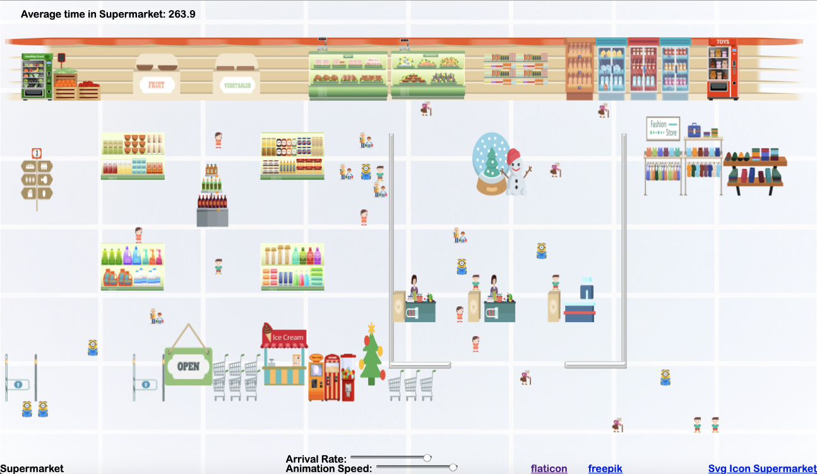
How does it work?
These slidebar
allows user to
increase or
decrease the
arrival rate of the
customers and the
animation speed
repectively

